Slide 1
Introduction

Slide 2
Uses of Computer Networks
  Business Applications
  Home Applications
  Mobile Users
  Social Issues

Slide 3
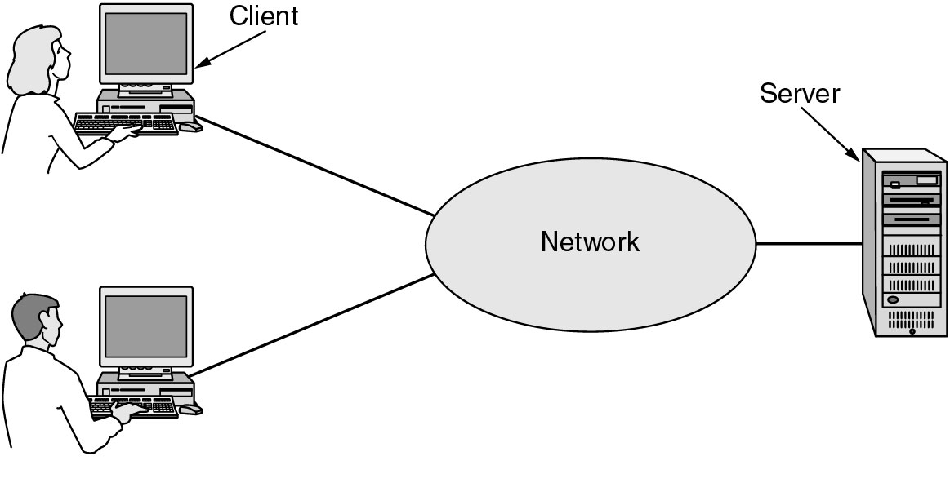
Business Applications of Networks
A network with two clients and one server.

Slide 4
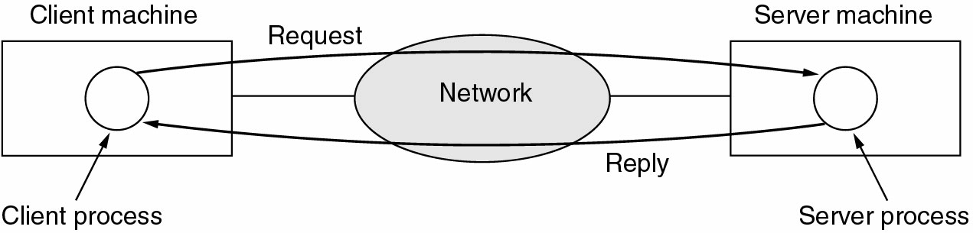
Business Applications of Networks (2)
The client-server model involves requests and replies.

Slide 5
Home Network Applications
Access to remote information
Person-to-person communication
Interactive entertainment
Electronic commerce

Slide 6
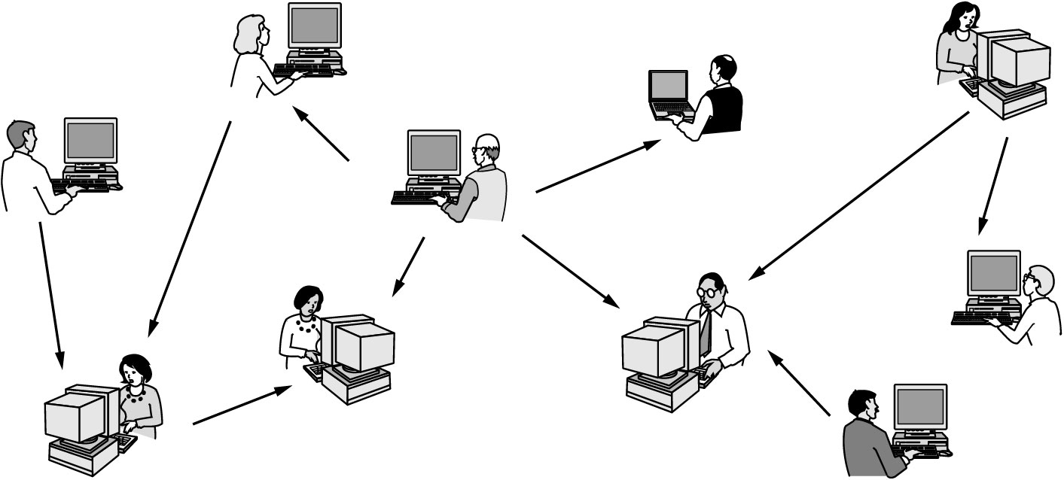
Home Network Applications (2)
In peer-to-peer system there are no fixed clients and servers.

Slide 7
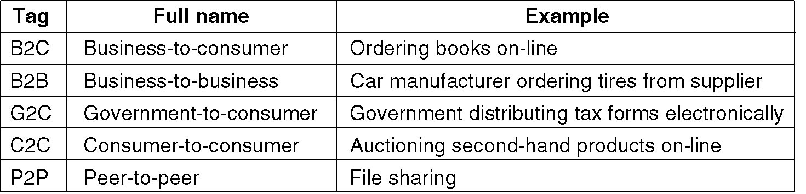
Home Network Applications (3)
Some forms of e-commerce.

Slide 8
Social Issues
Network Neutrality
Piracy
Snooping
Privacy issues
Phishing

Slide 9
Network Hardware
Local Area Networks
Metropolitan Area Networks
Wide Area Networks
Wireless Networks
Home Networks
Internetworks

Slide 10
Transmission Technology
Types of transmission technology
Broadcast links
Point-to-point links

Slide 11
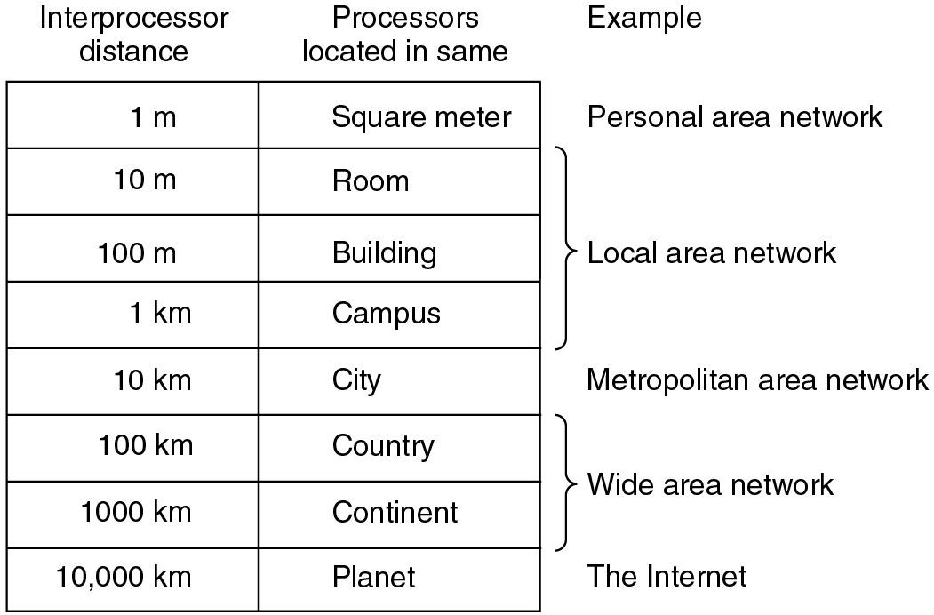
Physical Size of Networks
Classification of interconnected processors by scale.

Slide 12
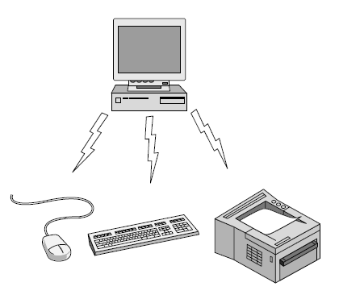
Personal Area Networks
Bluetooth PAN configuration.

Slide 13
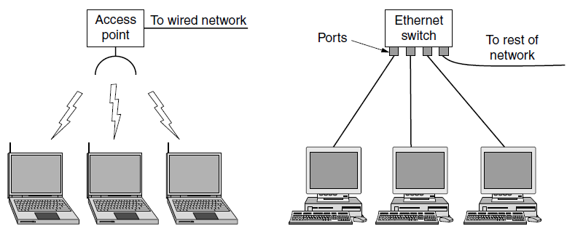
Local Area Networks
Wireless and wired LANs
802.11
Switched Ethernet

Slide 14
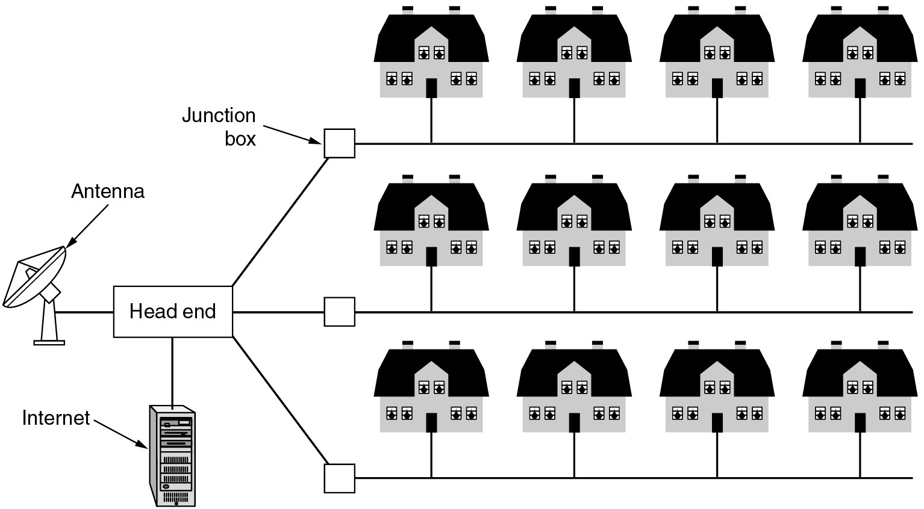
Metropolitan Area Networks
A metropolitan area network based on cable TV.

Slide 15
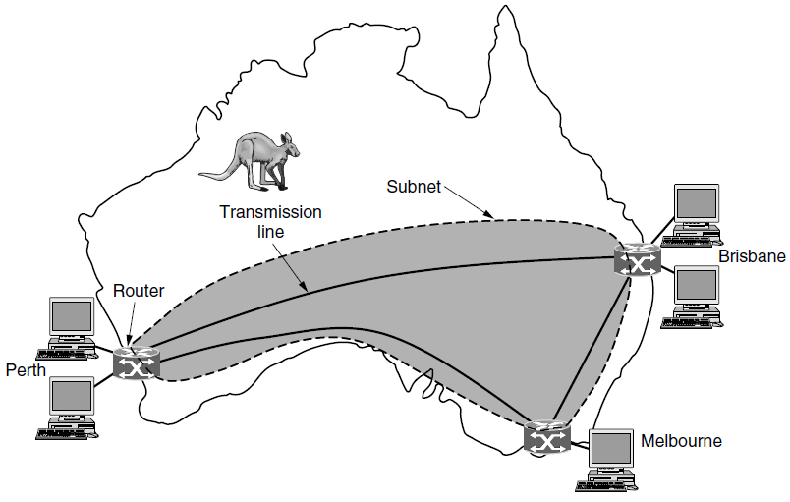
Wide Area Networks
WAN that connects three branch offices in Australia.

Slide 16
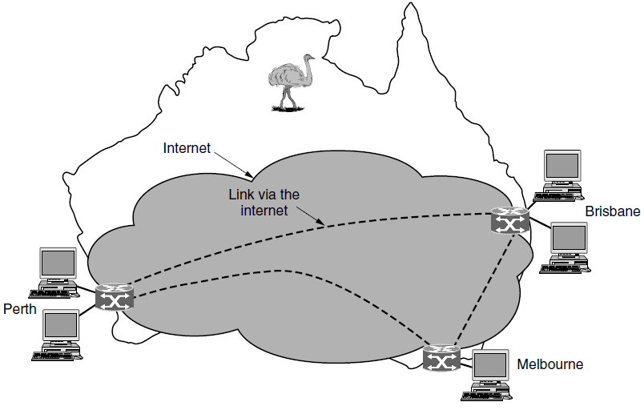
Wide Area Networks (2)
WAN using a virtual private network.

Slide 17
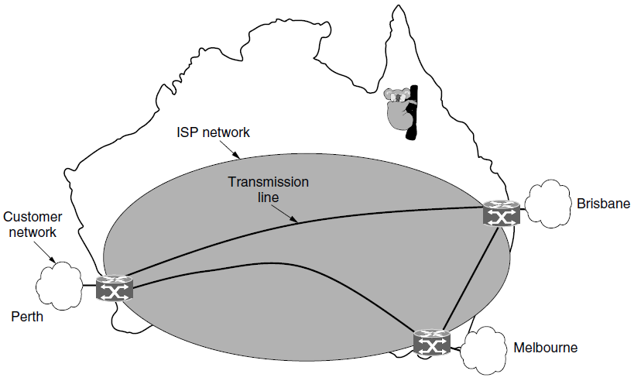
Wide Area Networks (3)
WAN using an ISP network.

Slide 18
Internetworks/Internet
Collection of interconnected networks
Gateway – machine that makes a connection between two or more networks

Slide 19
Network Software
Protocol Hierarchies
Design Issues for the Layers
Connection-Oriented and Connectionless Services
Service Primitives
The Relationship of Services to Protocols

Slide 20
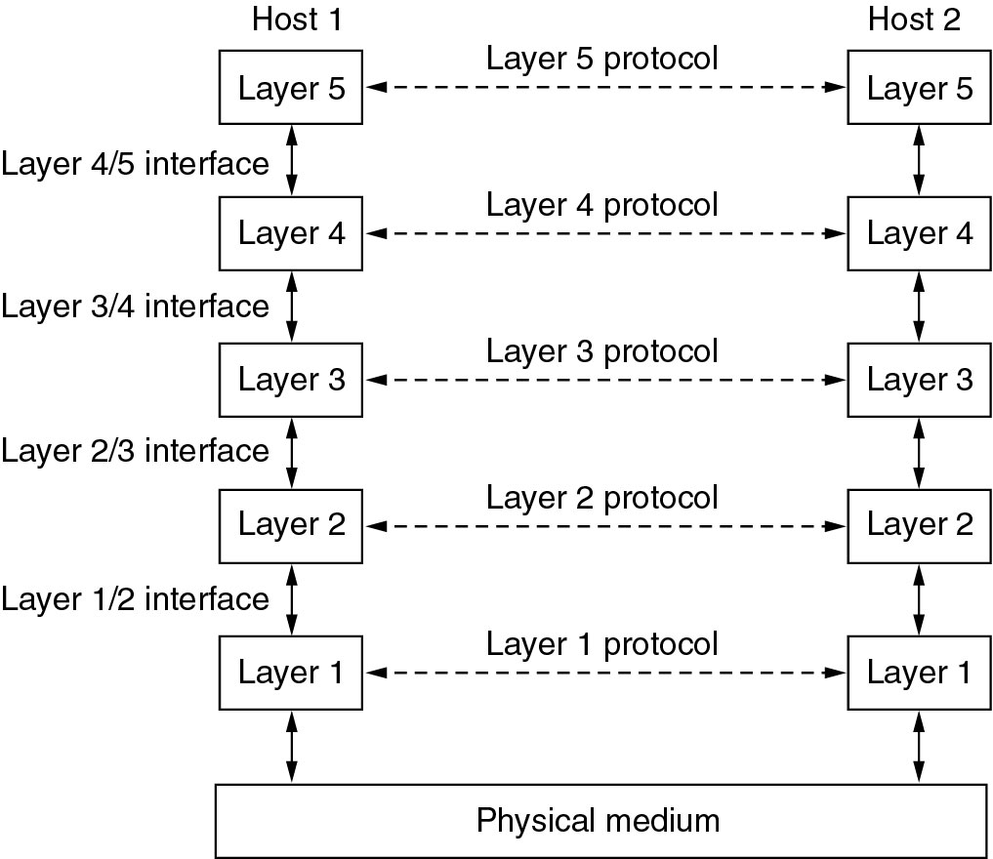
Network Software
Protocol Hierarchies
Layers, protocols, and interfaces.

Slide 21
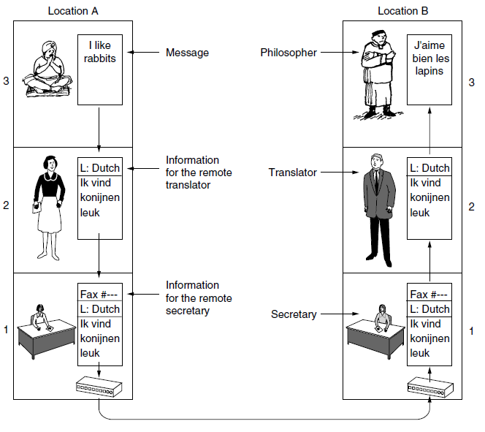
Protocol Hierarchies (2)
The philosopher-translator-secretary architecture.

Slide 22
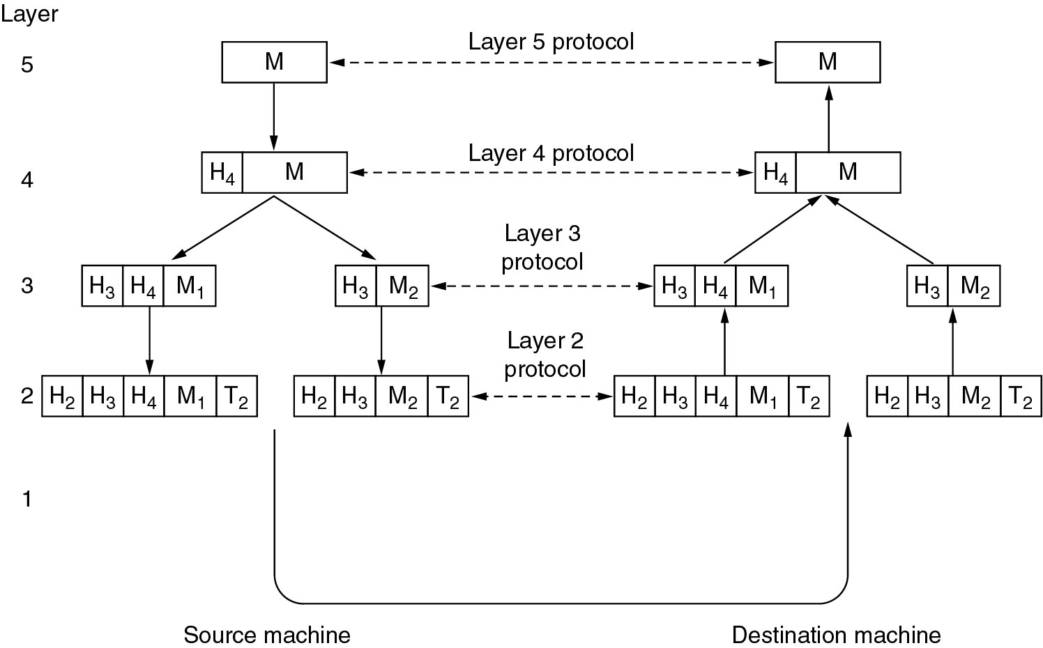
Protocol Hierarchies (3)
Example information flow supporting virtual communication in layer 5.

Slide 23
Design Issues for the Layers
Addressing
Error Control
Flow Control
Multiplexing
Routing

Slide 24
Connection-Oriented and Connectionless Services
Connection-oriented (telephonic system)
Sender, receiver and subnet needs to have a negotiation about the parameters to be used
Parameters – maximum message size, quality of services required and other issues
Connection-less (postal service)
Quality of Service

Slide 25
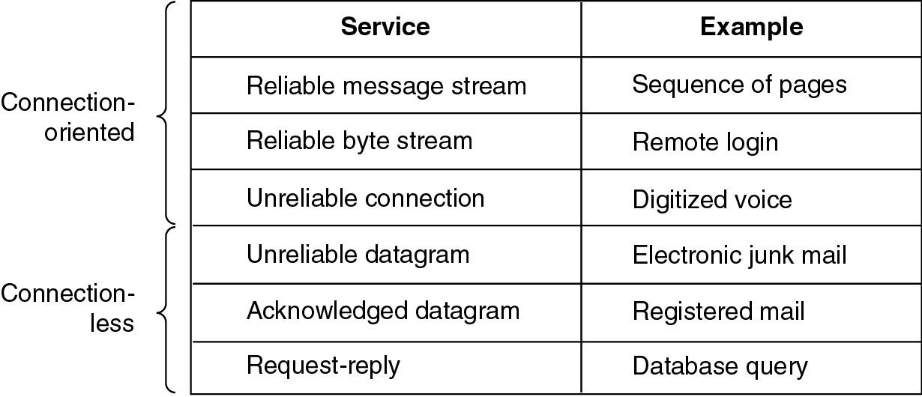
Connection-Oriented and Connectionless Services
Six different types of service.
Notes:
Request-reply – Client issues request, server answers.

Slide 26
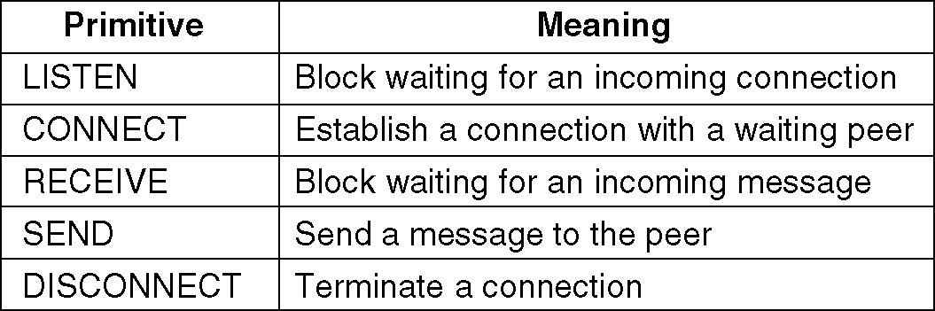
Service Primitives
Listen – server, Connect – client to server and then connection is established
Five service primitives for implementing a simple connection-oriented service.

Slide 27
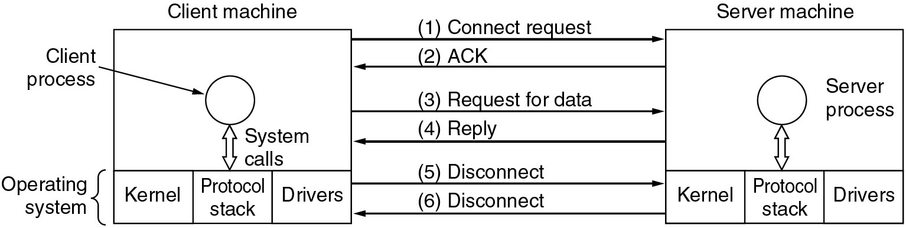
Service Primitives (2)
A simple client-server interaction using acknowledged datagrams.

Slide 28
Difficulties
Unreliable networks
Synchronization problem

Slide 29
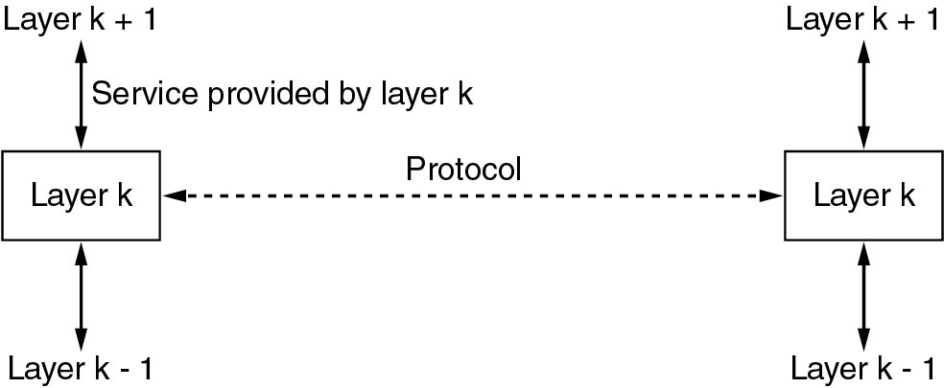
Services to Protocols Relationship
Service – Abstract Data Type or an object in an object-oriented language
The relationship between a service and a protocol.

Slide 30
Introduction
Reference Models

Slide 31
Reference Models
The OSI Reference Model
The TCP/IP Reference Model
A Comparison of OSI and TCP/IP
A Critique of the OSI Model and Protocols
A Critique of the TCP/IP Reference Model

Slide 32
Reference Models (Contd.)
A layer is created where a different abstraction is needed
Each layer should perform a well-defined function
The function of each layer should be chosen with an eye toward defining internationally standardized protocols
The layer boundary should be chosen to minimize the information flow across interfaces
The number of layers should be large enough that distinct functions need not be thrown together out of necessity and small enough that the architecture does not become unweildy

Slide 33
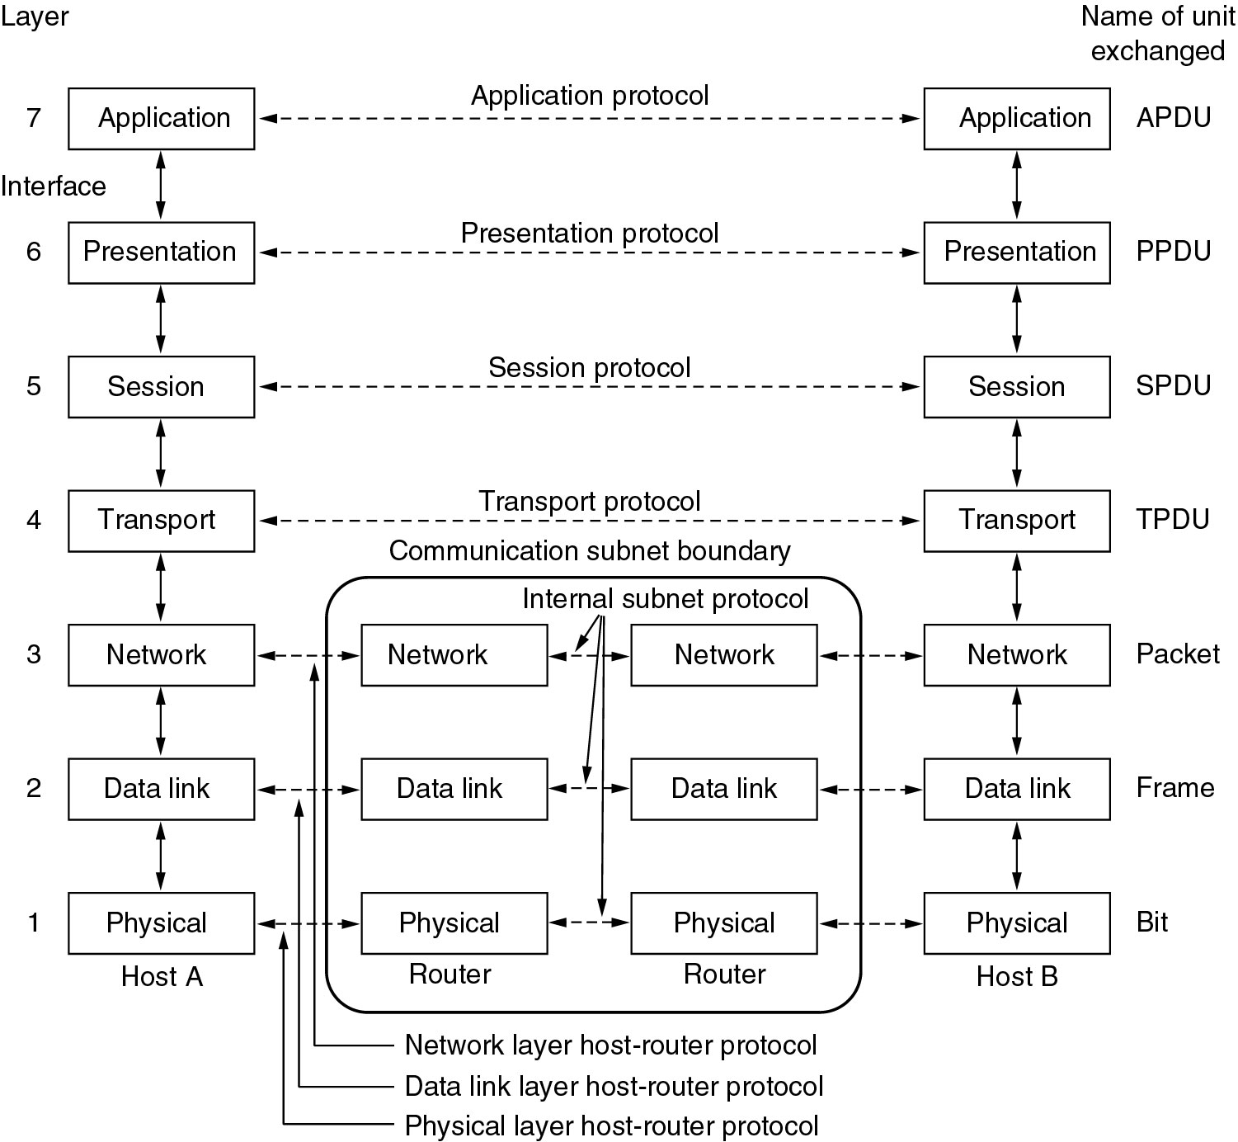
Reference Models
The OSI reference model.

Slide 34
Physical Layer (questions)
How many volts should be used to represent 1?
How many nanoseconds does a bit last?
Transmission may proceed in one direction or multiple directions.
How will the initial connection be established?
How many pins does the network connector have?

Slide 35
DataLink Layer
Raw transmission facility in a line that appears free of undetected errors to the network layer.
Data frames → acknowledgement frame

Slide 36
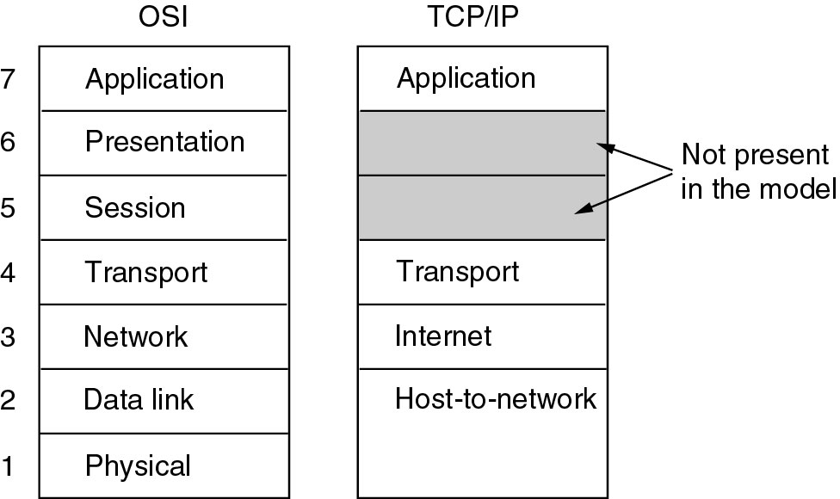
Reference Models (2)
The TCP/IP reference model.

Slide 37
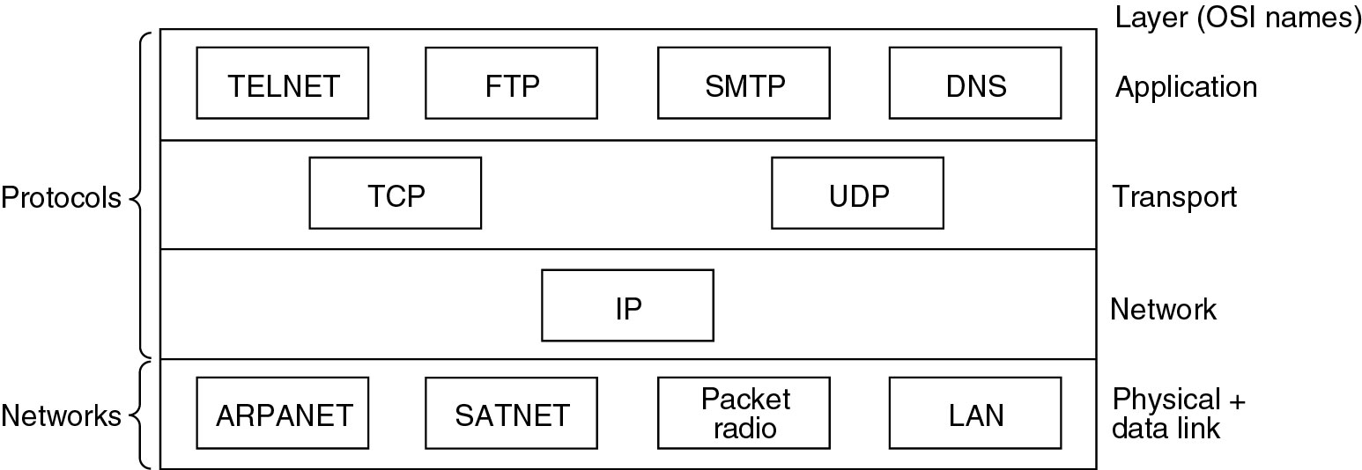
Reference Models (3)
Protocols and networks in the TCP/IP model initially.

Slide 38
IP Layer
Packet Switching - a mode of data transmission in which a message is broken into a number of parts which are sent independently, over whatever route is optimum for each packet, and reassembled at the destination.
Transport Layer
TCP – Flow control
UDP – Fast Delivery

Slide 39
Comparing OSI and TCP/IP Models
Concepts central to the OSI model
Services
Interfaces
Protocols
TCP – retrofit/
OSI – DataLink Layer (point-to-point) –difficult when broadcast network came

Slide 40
Differences between OSI and TCP/IP model
OSI model supports connectionless and connection-oriented communication in the network layer but only connection-oriented communication in the transport layer
TCP/IP model has one mode in the network layer (connectionless) but supports both modes in the transport layer

Slide 41
A Critique of the OSI Model and Protocols
Why OSI did not take over the world
Bad timing
Bad technology
Bad implementations
Bad politics

Slide 42
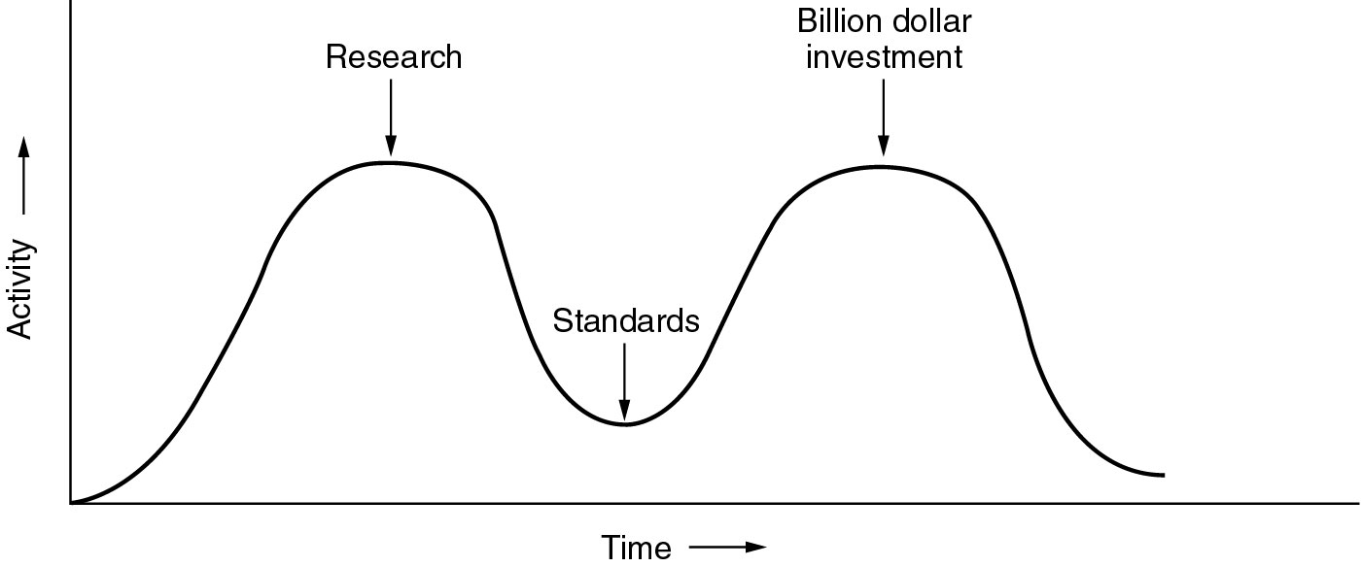
Bad Timing
The apocalypse of the two elephants. (Standard came much later)

Slide 43
Bad Implementation
Initial version were huge, unwieldy and slow.
Bad Politics
TCP/IP part of Unix, OSI – governement pushed

Slide 44
A Critique of the TCP/IP Reference Model
Problems:
Service, interface, and protocol not distinguished
Not a general model (describing bluetooth is not possible by TCP)
Host-to-network “layer” not really a layer
No mention of physical and data link layers
Minor protocols deeply entrenched, hard to replace
(TELNET, for example, was designed for a ten character-per-second mechanical Teletype terminal. It knows nothing of graphical user interfaces and mice).

Slide 45
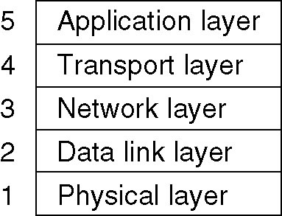
Hybrid Model
The hybrid reference model to be used in this course.

Slide 46
Example Networks
The Internet
Connection-Oriented Networks:
X.25, Frame Relay, and ATM
Ethernet
Wireless LANs: 802:11

Slide 47
End

